Slide 1
Neural network and learning machines
Linear regression with multiple variables Polynomial regression
Lecture 3
Credits: This material is based mainly on Andrew NG’s Coursera ML course

Slide 2


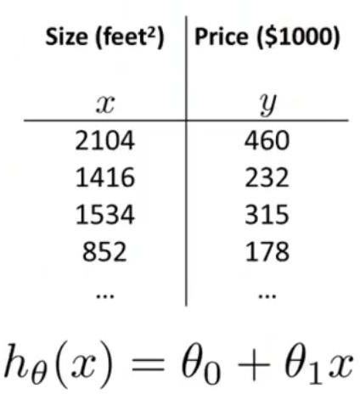

Slide 3


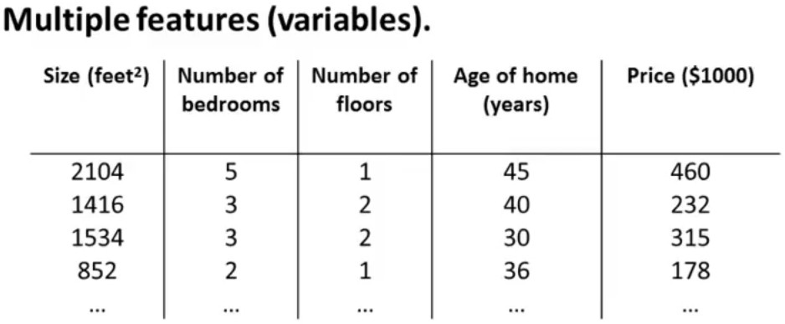
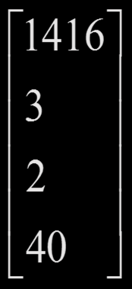
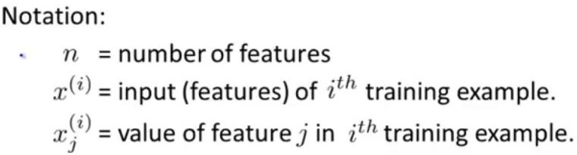
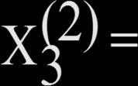
X₁
X₂
X₃
X₄
y
m=47
⎡1416⎤
⎢₃ ⎥
⎢ ⎥
⎢2 ⎥
⎢ ⎥
40 ⎦
_{x} (2) ₌
n=4
_{X}(2) ₌ ₂
⎣
3

Slide 4


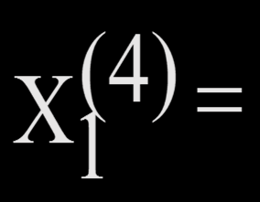
X₁
X₂
X₃
X₄
y
_{X}(4) ₌
852
1

Slide 5
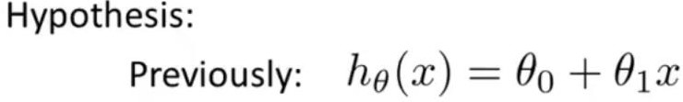
The weights used by the model indicate the effect of each descriptive feature on the predictions returned by the model
h_{θ}= 80 + 0.1x1+ 3x2 + 0.01x3 − 2x4
Base Price
no. of bedroom
age of house
size
no. of floor

Slide 7
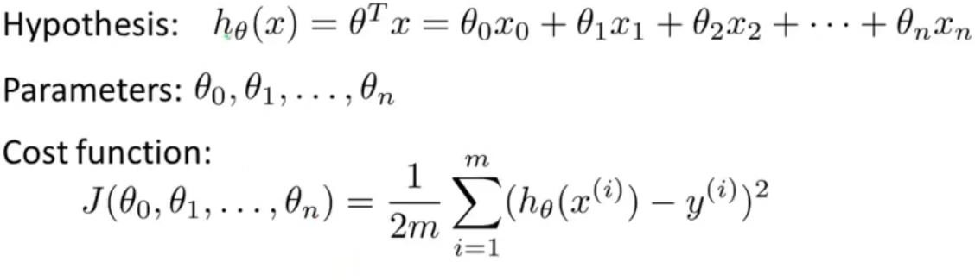
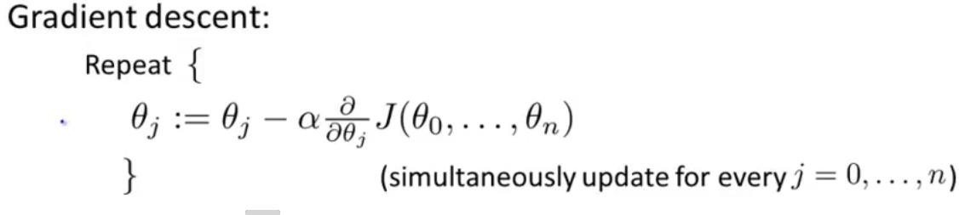

Slide 8
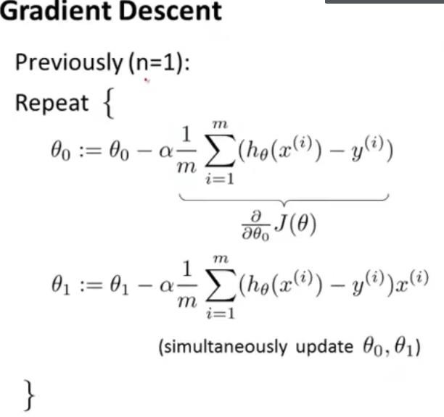
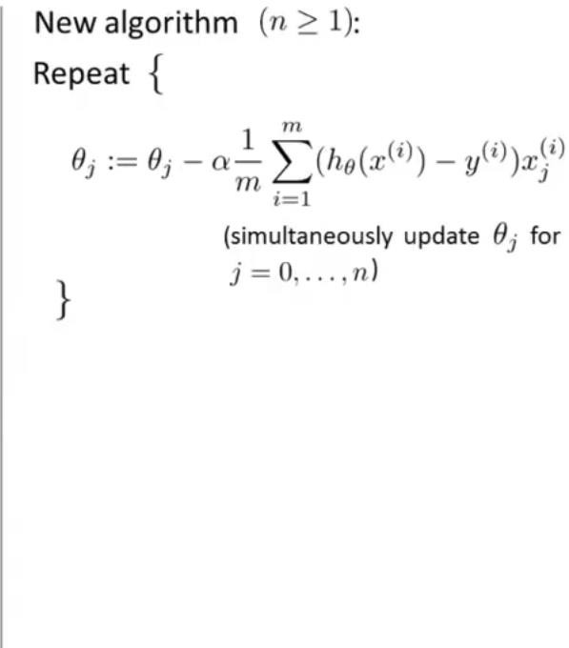
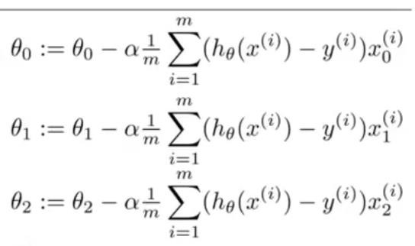
X ₀ =1

Slide 10


Slide 11
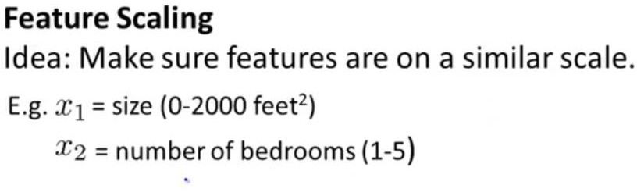
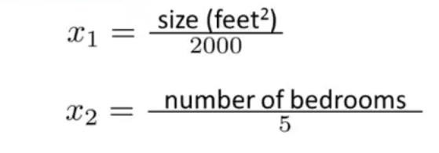


0 ≤ x1 ≤ 1
0 ≤ x2 ≤ 1

Slide 12




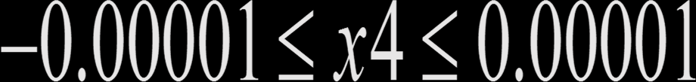

More generally, when we're performing feature scaling, what we often want to do is get every feature into approximately a -1 to +1 range and concretely, your feature x₀ is always equal to 1. So, that's already in that
range,
−1 ≤ xi ≤ 1
−100 ≤ x3 ≤ 100
− 0. 0 0 0 01 ≤ x4 ≤ 0.00001
0 ≤ x1 ≤ 3
−2 ≤ x2 ≤ 0.5

Slide 13
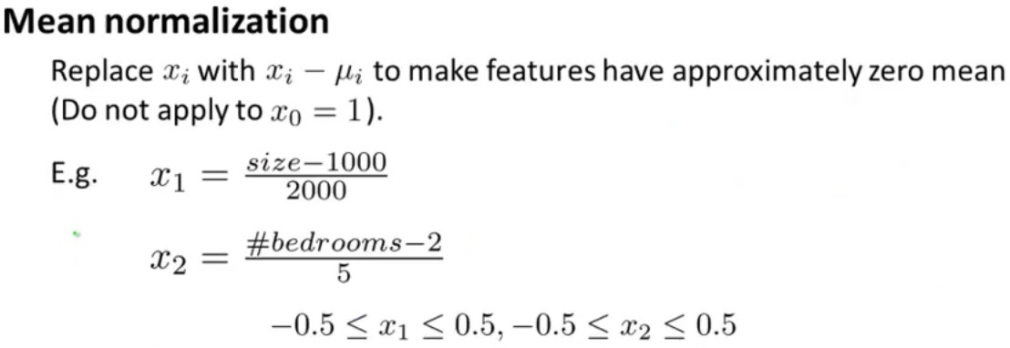
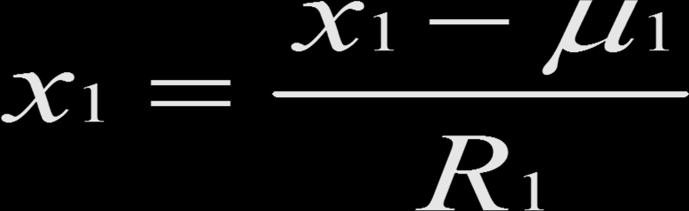
Average of x1 in the training set
x1 − μ1
x1 =
R1
Range

Slide 14



Slide 15
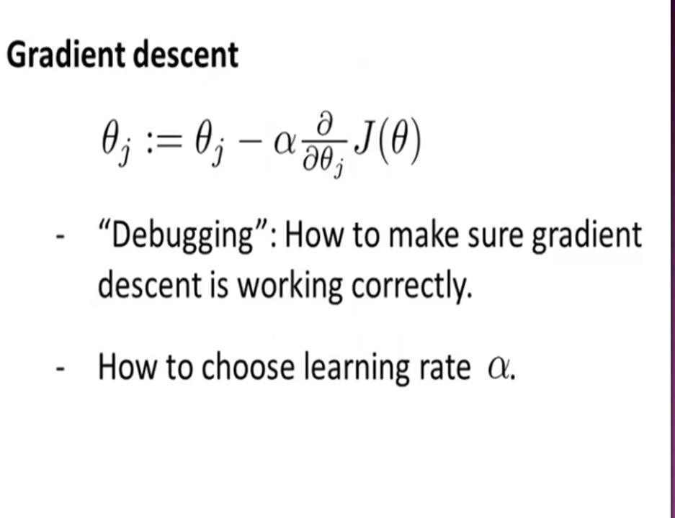

Slide 16
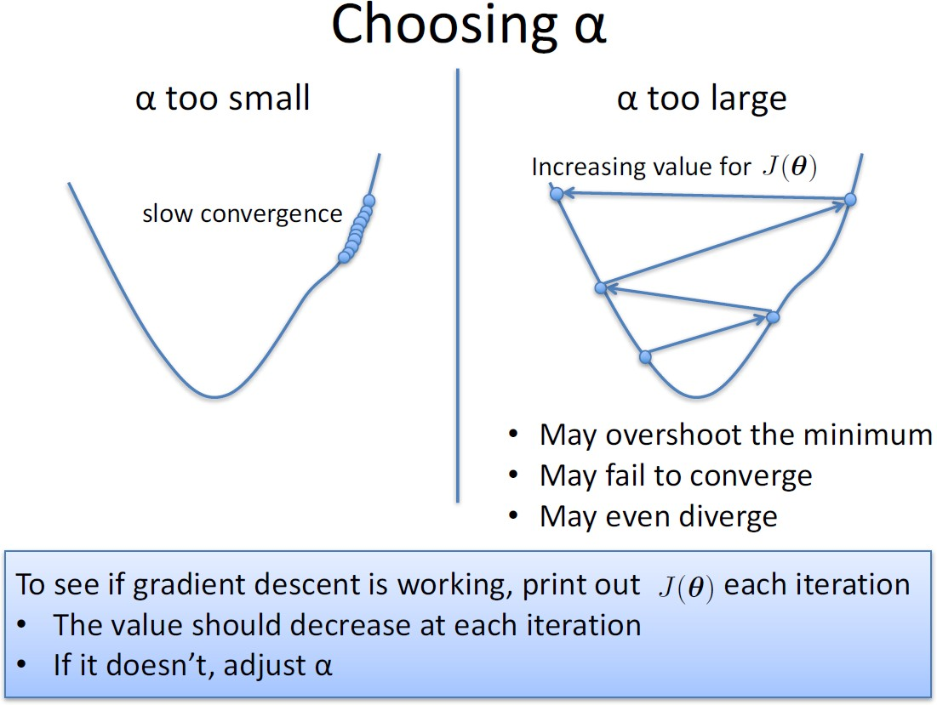

Slide 17
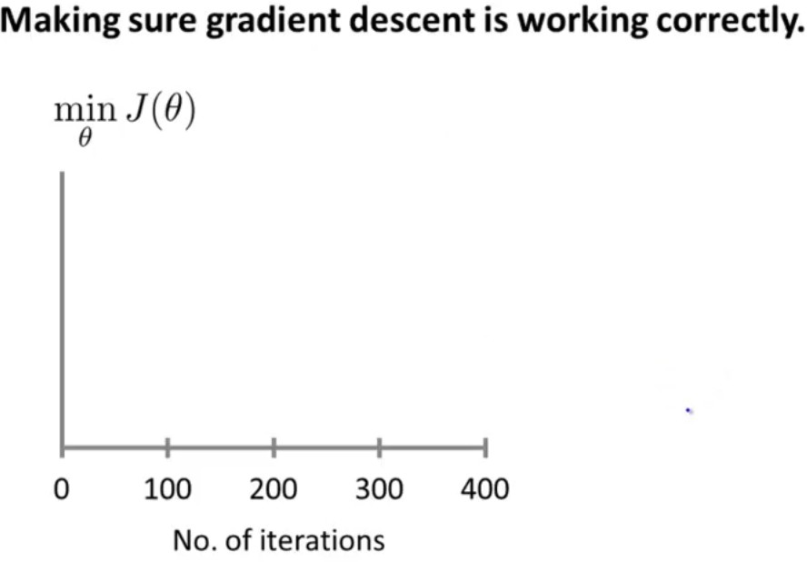
if gradient is working properly then J(Ɵ) should decrease after every iteration.
J(Ɵ1)
J(Ɵ2)
J(Ɵ3)
θ3
θ1
θ2

Slide 18
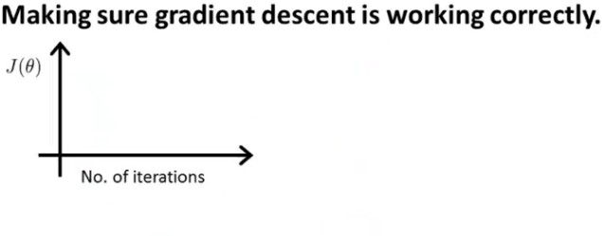
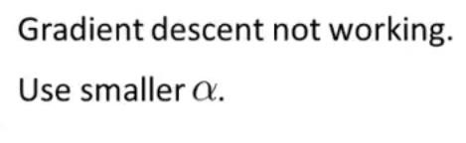
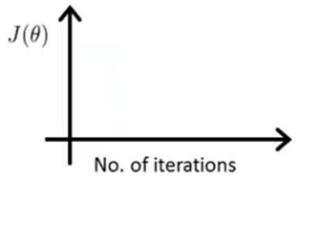
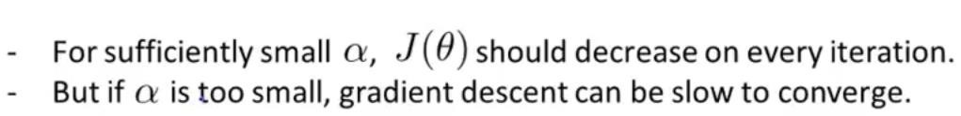

Slide 19
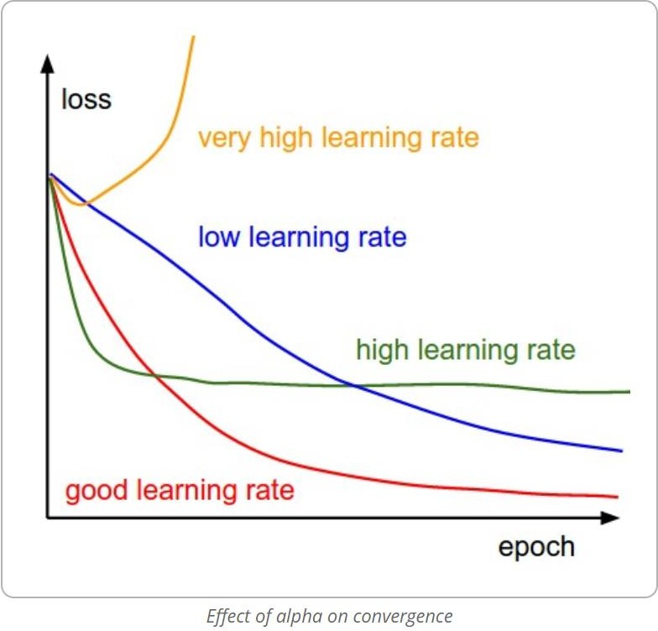
1
The yellow plot shows the divergence of the algorithm when the learning rate is really high where in the learning steps overshoot.
The green plot shows the case where learning rate is not as large as the previous case but is high enough that the steps keep oscillating at a point which is not the minima.
The red plot would be the optimum curve for the cost drop as it drops steeply initially and then saturates very close to the optimum value.
The blue plot is the least value
of α and converges very slowly as the steps taken by the algorithm during update steps are very small.

Slide 20
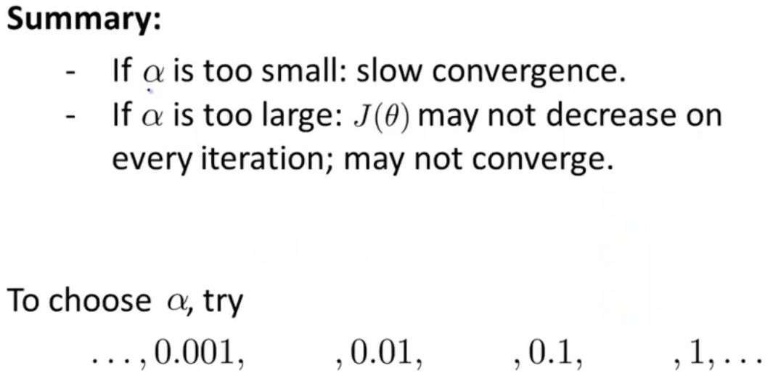
In order to choose optimum value of α run the algorithm with different values like:
0.003 0.03 0.3
plot the learning curve to understand whether the value should be increased or decreased.

Slide 22


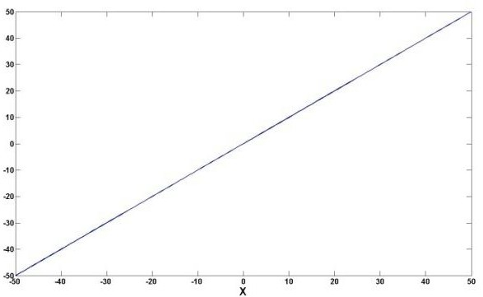
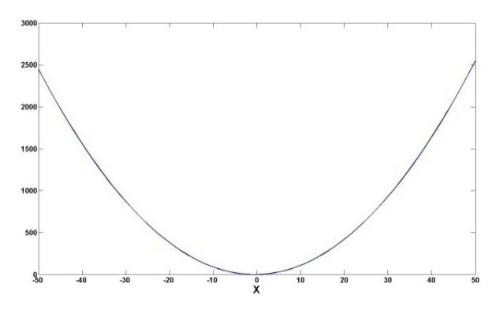
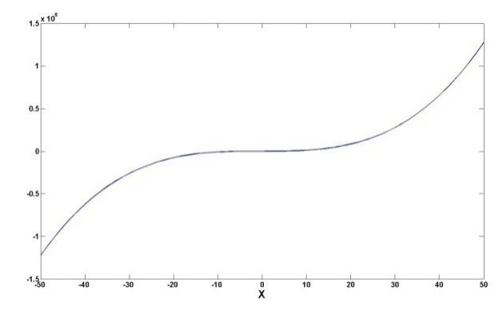
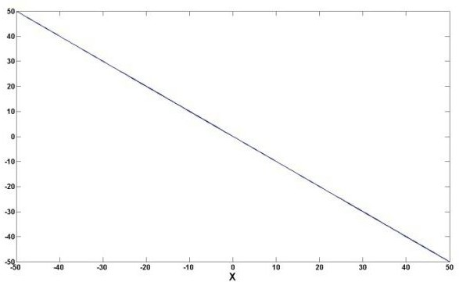
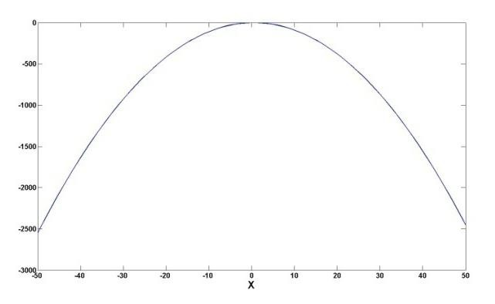
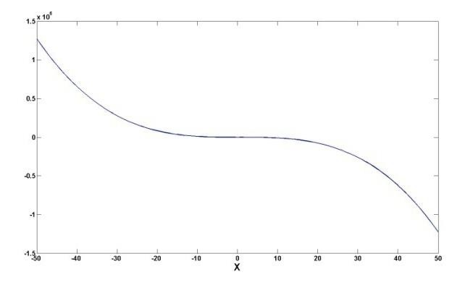
The sign of the coefficient for the highest order regressor determines the direction of the curvature
Linear | Quadratic | Cubic
Y’ = 0 + 1X | Y’ = 0 + 1X + 1X² | Y’ = 0 + 1X + 1X² + 1X³
Y’ = 0 + -1X
Y’ = 0 + 1X + -1X²
Y’ = 0 + 1X + 1X² + -1X³
25

Slide 23
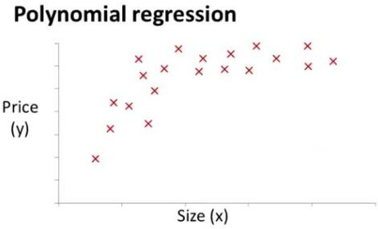
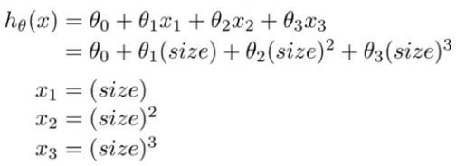
hθ(xθ=)₀θ+₁x₁θ+₂x₁ ²
hθ(xθ=)₀θ+₁x₁θ+₂x₁ ²θ +₃x₁ ³
Size | 1-1000
size² | 1-1000 000
size³ | 1- 1000 000 000
Range

Slide 24


Generalization in Machine Learning
The goal of a good machine learning model is to generalize well from the training data to any data from the problem domain. This allows us to make predictions in the future on data the model has never seen. “learning general concepts from specific examples”
There is a terminology used in machine learning when we talk about how well a machine learning model learns and generalizes to new data, namely overfitting and underfitting.
Overfitting and underfitting are the two biggest causes for poor
performance of machine learning algorithms.

Slide 25
Over-fitting
Overfitting refers to a model that models the training data too well.
Overfitting happens when a model learns the detail and noise in the training data to the extent that it negatively impacts the performance of the model on new data. This means that the noise or random fluctuations in the training data is picked up and learned as concepts by the model. The problem is that these concepts do not apply to new data and negatively impact the models ability to generalize.
decision trees are a machine learning algorithm that is very flexible and is subject to overfitting training data.

Slide 26
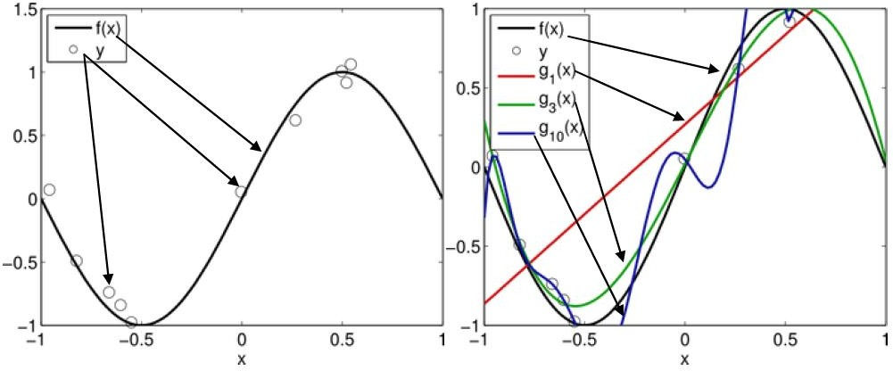
Under-fitting
Underfitting refers to a model that can neither model the training
data nor generalize to new data.
An underfitting machine learning model is not a suitable model and
will be obvious as it will have poor performance on the training data.

Slide 27


A Good Fit in Machine Learning
Ideally, you want to select a model at the sweet spot between underfitting and overfitting.
The sweet spot is the point just before the error on the test dataset starts to increase where the model has good skill on both the training dataset and the unseen test dataset.
Both overfitting and underfitting can lead to poor model performance. But by
far the most common problem in applied machine learning is overfitting.
in order to limit overfitting by using a resampling technique (k-fold cross validation) to estimate model accuracy.
k-fold cross validation allows you to train and test your model k-times on different subsets of training data and build up an estimate of the performance of a machine learning model on unseen data.

Slide 28
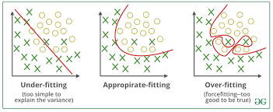
Example

Slide 29
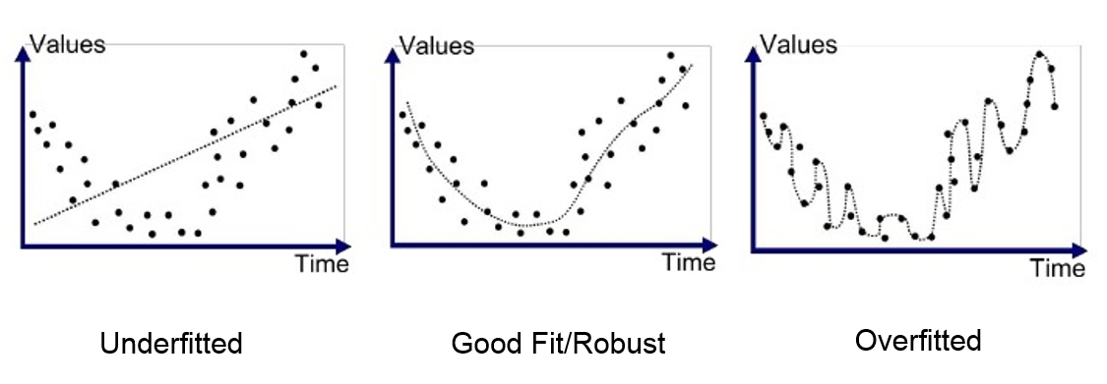
Example 2

Slide 30
Thanks

